Slide 1

Real-time Smile Detection and Tracking.
Presented by
N Hariharan
Register No : 22EC077
Sk Abdul Baseed
Register No:22EC106
DEPARTMENT OF ECE
CHENNAI INSTITUTE OF TECHNOLOGY(An Autonomous Institution)

Slide 2
Problem Statement/Definition
The problem is to develop a real-time smile detection and tracking system using computer vision techniques. The system should be able to analyze video streams from a webcam and accurately identify faces in the frames. It should further detect and track smiles within the detected faces, providing visual feedback by drawing rectangles around the faces and smiles. The objective is to create a robust and efficient smile detection algorithm that can be used in various applications, such as emotion recognition, user engagement analysis, or interactive interfaces. The system should deliver accurate and prompt smile detection results, even in varying lighting conditions and different face orientations.

Slide 3
Proposed Solution
Our proposed solution is to develop a real-time smile detection and tracking system using computer vision techniques. The system will leverage the OpenCV library, which provides pre-trained Haar cascade classifiers for face and smile detection. By following these steps, we can achieve the desired functionality:
Access Webcam: Utilize OpenCV's VideoCapture module to access the webcam and capture real-time video frames.
Grayscale Conversion: Convert each captured frame to grayscale using OpenCV's cvtColor() function. This simplifies the subsequent face and smile detection process.
Face Detection: Apply the Haar cascade classifier for face detection to the grayscale frame using OpenCV's detectMultiScale() function. This step will identify the positions and sizes of faces within the frame.
Smile Detection: For each detected face, extract a region of interest (ROI) from the grayscale frame. Apply the Haar cascade classifier for smile detection to the ROI using OpenCV's detectMultiScale() function. This will identify the positions and sizes of smiles within the ROI.
Visualization: Draw rectangles around the detected faces and smiles using OpenCV's rectangle() function. Display the video frame with the drawn rectangles using OpenCV's imshow() function. Provide textual feedback above each face rectangle to indicate whether the person is smiling or not.
Real-time Processing: Continuously loop through the frames, repeating the face and smile detection process for each frame. Allow the user to exit the loop by pressing a key (e.g., 'c').
System Integration: Package the solution into a standalone application or integrate it into a larger project based on specific requirements.
Testing and Optimization: Test the system with various scenarios, lighting conditions, and individuals to evaluate its performance. Optimize the parameters of the Haar cascade classifiers, such as the scale factor and minimum neighbors, to improve detection accuracy and efficiency.
By implementing this solution, we can develop a real-time smile detection and tracking system suitable for applications requiring smile analysis and engagement detection based on video streams from a webcam.

Slide 4
Code
import cv2
face_cascade = cv2.CascadeClassifier(cv2.data.haarcascades + 'haarcascade_frontalface_default.xml')
smile_cascade = cv2.CascadeClassifier(cv2.data.haarcascades + 'haarcascade_smile.xml')
cap = cv2.VideoCapture(0)
while True:
ret, frame = cap.read()
if not ret:
break
gray = cv2.cvtColor(frame, cv2.COLOR_BGR2GRAY)
faces = face_cascade.detectMultiScale(gray, scaleFactor=1.3, minNeighbors=5)
for (x, y, w, h) in faces:
roi_gray = gray[y:y+h, x:x+w]
roi_color = frame[y:y+h, x:x+w]
smiles = smile_cascade.detectMultiScale(roi_gray, scaleFactor=1.7, minNeighbors=22)
cv2.rectangle(frame, (x, y), (x+w, y+h), (255, 0, 0), 2)

Slide 5
Code
for (sx, sy, sw, sh) in smiles:
cv2.rectangle(roi_color, (sx, sy), (sx+sw, sy+sh), (0, 255, 0), 2)
if len(smiles) > 0:
cv2.putText(frame, 'smiling', (x, y-10), cv2.FONT_HERSHEY_SIMPLEX, 0.9, (0, 255, 0), 2)
else:
cv2.putText(frame, 'not smiling', (x, y-10), cv2.FONT_HERSHEY_SIMPLEX, 0.9, (0, 0, 255), 2)
cv2.imshow('Smile Detector', frame)
if cv2.waitKey(1) & 0xFF == ord('c'):
break
cap.release()
cv2.destroyAllWindows()

Slide 6
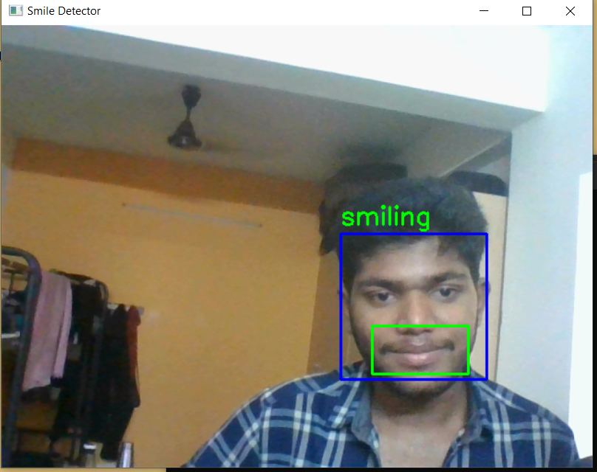
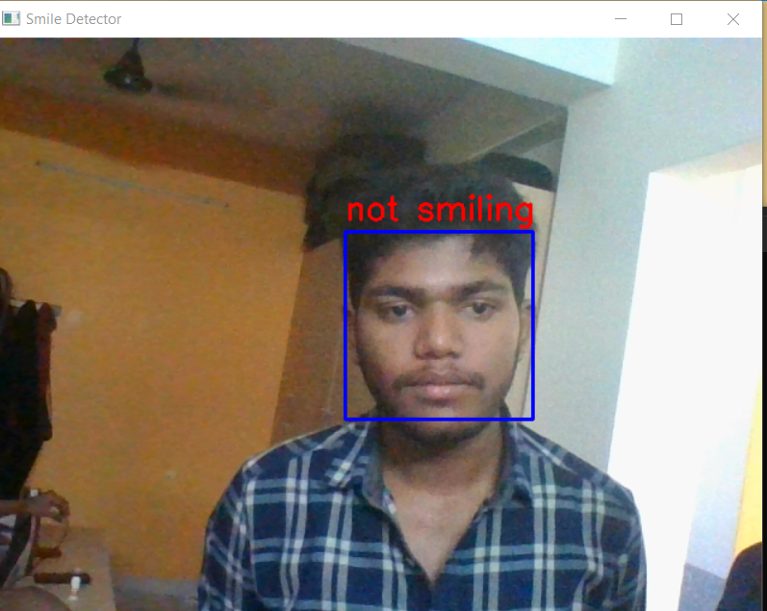
Output snapshots
screenshots

Slide 7
Future Enhancement
Emotion Recognition: Expand the system to detect and recognize a wider range of facial expressions beyond just smiles. This could include emotions like happiness, sadness, anger, surprise, etc. By incorporating additional trained models or machine learning techniques, the system can provide more comprehensive emotion analysis.
Multiple Face Tracking: Enhance the system to detect and track multiple faces simultaneously. This would be particularly useful in scenarios involving group interactions or crowd monitoring, where the system can analyze the collective engagement or emotional state.
Deep Learning Approaches: Explore the use of deep learning models, such as Convolutional Neural Networks (CNNs) or Recurrent Neural Networks (RNNs), to improve the accuracy of face and smile detection. Deep learning models have shown promising results in computer vision tasks and may provide more robust and accurate detection capabilities.
User-specific Profiles: Develop a feature to create user-specific profiles based on detected smiles or emotions over time. This can be useful for personalized experiences, such as adaptive user interfaces, emotion-based content recommendations, or targeted advertising.
Tracking Metrics and Analytics: Incorporate metrics and analytics to gather statistics on smile occurrences, duration, or intensity. These insights can be valuable for applications in marketing, user experience evaluation, or psychological research.

Slide 8
References
OpenCV Documentation: The official documentation of OpenCV provides comprehensive information about the library, including tutorials, examples, and detailed explanations of various functions and modules. You can find the documentation at: https://docs.opencv.org/
OpenCV GitHub Repository: The OpenCV repository on GitHub contains the source code and examples of various computer vision applications. You can explore the repository to find specific code samples or contribute to the development of OpenCV. The repository can be found at: https://github.com/opencv/opencv
Research Papers: To delve deeper into specific topics related to smile detection, facial recognition, and computer vision, you can explore research papers published in relevant conferences and journals. Platforms like Google Scholar or IEEE Xplore can be valuable resources for finding academic papers in the field of computer vision.
Online Tutorials and Blogs: Numerous online tutorials and blogs provide step-by-step guides, explanations, and code examples for smile detection and computer vision projects using OpenCV. Websites like PyImageSearch (https://www.pyimagesearch.com/) and Learn OpenCV (https://learnopencv.com/) offer tutorials and articles on various computer vision topics.
DEPARTMENT OF ECE
CHENNAI INSTITUTE OF TECHNOLOGY

